Slide 1
Clustering
Some material borrowed from course materials of Andrew Ng

Slide 2
Unsupervised learning
Given a set of unlabeled data points / items
Find patterns or structure in the data
Clustering: automatically group the data points /
items into groups of ‘similar’ or ‘related’ points

Slide 3
Motivations for Clustering
Understanding the data better
  Grouping Web search results into clusters, each of which
captures a particular aspect of the query
  Segment the market or customers of a service
As precursor for some other application
  Summarization and data compression
  Recommendation

Slide 4
Clustering for Data Understanding and Applications
Biology: taxonomy of living things: kingdom, phylum, class, order, family, genus
and species
Information retrieval: document clustering
Land use: Identification of areas of similar land use in an earth observation
database
Marketing: Help marketers discover distinct groups in their customer bases, and then use this knowledge to develop targeted marketing programs
City-planning: Identifying groups of houses according to their house type, value,
and geographical location
Earth-quake studies: Observed earth quake epicenters should be clustered along continent faults
Climate: understanding earth climate, find patterns of atmospheric and ocean
Economic Science: market resarch
4

Slide 5
Clustering as a Preprocessing Tool (Utility)
Summarization:
  Preprocessing for regression, PCA, classification, and association analysis
Compression:
  Image processing: vector quantization
Finding K-nearest Neighbors
  Localizing search to one or a small number of clusters
Outlier detection
  Outliers are often viewed as those “far away” from any cluster
5

Slide 6
Different types of clustering
Partitional (Hard Clustering)
  Divide set of items into non-overlapping subsets
  Each item will be member of one subset
Overlapping (Soft Clustering)
  Divide set of items into potentially overlapping subsets
  Each item can simultaneously belong to multiple subsets

Slide 7
Partitional Clustering (Hard)
Original Points
A Partitional Clustering

Slide 8
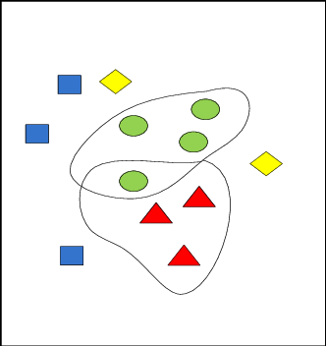
Overlapping (Soft Clustering)

Slide 9
Different types of clustering
Fuzzy (Soft Clustering)
  Every item belongs to every cluster with a membership weight between 0 (absolutely does not belong) and 1 (absolutely belongs)
  Usual constraint: sum of weights for each individual item
should be 1
  Convert to partitional clustering: assign every item to that cluster for which its membership weight is highest

Slide 10
Different types of clustering
Hierarchical
  Set of nested clusters, where one larger cluster can contain
smaller clusters
  Organized as a tree (dendrogram): leaf nodes are singleton clusters containing individual items, each intermediate node is union of its children sub-clusters
  A sequence of partitional clusterings – cut the dendrogram at a certain level to get a partitional clustering

Slide 11
Hierarchical Clustering
p1
p3
p4
p2
p1 p2 p3 p4
Traditional Dendrogram
Traditional Hierarchical Clustering
p1
p3
p4
p2
p1 p2 p3 p4
Non-traditional Dendrogram
Non-traditional Hierarchical Clustering

Slide 12
Different types of clustering
Complete vs. partial
  A complete clustering assigns every item to one or more
clusters
  A partial clustering may not assign some items to any cluster (e.g., outliers, items that are not sufficiently similar to any other item)

Slide 13
Types of clustering methods
Prototype-based
– Each cluster defined by a prototype (centroid or medoid),
i.e., the most representative point in the cluster
A cluster is the set of items in which each item is closer (more similar) to the prototype of this cluster, than to the prototype of any other cluster
Example method: K-means

Slide 14
Types of clustering methods
Density-based
  Assumes items distributed in a space where ‘similar’ items
are placed close to each other (e.g., feature space)
  A cluster is a dense region of items, that is surrounded by a region of low density
  Example method: DBSCAN

Slide 15
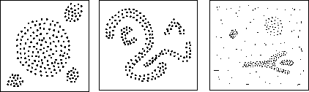
Density based clustering methods
Locates regions of high density, that are separated from one another by regions of low density

Slide 16

Types of Clusters: Density-Based
Density-based
  A cluster is a dense region of points, which is separated by low-
density regions, from other regions of high density.
  Used when the clusters are irregular or intertwined, and when noise and outliers are present.
6 density-based clusters

Slide 17
Why DBSCAN?
Partitioning methods (K-means, PAM clustering) and hierarchical clustering work for finding spherical-shaped clusters or convex clusters. In other words, they are suitable only for compact and well-separated clusters. Moreover, they are also severely affected by the presence of noise and outliers in the data.
Real life data may contain irregularities, like:
i) Clusters can be of arbitrary shape.
ii) Data may contain noise.

Slide 18
DBSCAN
DBSCAN: Density Based Spatial Clustering of Applications with Noise
  Proposed by Ester et al. in SIGKDD 1996
  First algorithm for detecting density-based clusters
Advantages (e.g., over K-means)
  Can detect clusters of arbitrary shapes (while clusters detected by K-means are usually globular (globe-shaped; spherical))
  Robust to outliers

Slide 19
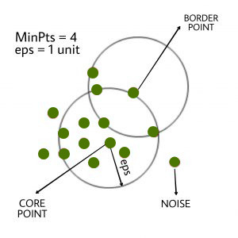
DBSCAN
DBSCAN algorithm requires two parameters:
eps : It defines the neighborhood around a data point i.e. if the distance between two points is lower or equal to ‘eps’ then they are considered as neighbors. If the eps value is chosen too small then large part of the data will be considered as outliers. If it is chosen very large then the clusters will merge and majority of the data points will be in the same clusters. One way to find the eps value is based on the k-distance graph.
MinPts: Minimum number of neighbors (data points) within eps radius. Larger the dataset, the larger value of MinPts must be chosen. As a general rule, the minimum MinPts can be derived from the number of dimensions D in the dataset as, MinPts >= D+1. The minimum value of MinPts must be chosen at least 3.
In this algorithm, we have 3 types of data points.
Core Point: A point is a core point if it has more than MinPts points within eps.
Border Point: A point which has fewer than MinPts within eps but it is in the neighborhood of a core point.
Noise or outlier: A point which is not a core point or border point.

Slide 20
DBSCAN algorithm steps:
1. Find all the neighbor points within eps and identify the core points or visited with more than MinPts neighbors.
2. For each core point if it is not already assigned to a cluster, create a new cluster.
3. Find recursively all its density connected points and assign them to the same cluster as the core point.
A point a and b are said to be density connected if there exist a point c which has a sufficient number of points in its neighbors and both the points a and b are within the eps distance. This is a chaining process. So, if b is neighbor of c, c is neighbor of d, d is neighbor of e, which in turn is neighbor of a implies that b is neighbor of a.
4. Iterate through the remaining unvisited points in the dataset. Those points that do not belong to any cluster are noise.

Slide 21
Types of clustering methods
Graph-based
  Assumes items represented as a graph/network where
items are nodes, and ‘similar’ items are linked via edges
  A cluster is a group of nodes having more and / or better connections among its members, than between its members and the rest of the network
  Also called ‘community structure’ in networks
  Example method: Algorithm by Girvan and Newman

Slide 22
K-means clustering

Slide 23
K-means
Prototype-based, partitioning technique
Finds a user-specified number of clusters (K)
Each cluster represented by its centroid item
There have been extensions where number of clusters is not needed as input

Slide 24
K-means algorithm
Given k
Randomly choose k data points (seeds) to be the initial cluster centres
Assign each data point to the closest cluster centre
Re-compute the cluster centres using the current cluster
memberships.
If a convergence criterion is not met, go to 2.
21

Slide 25
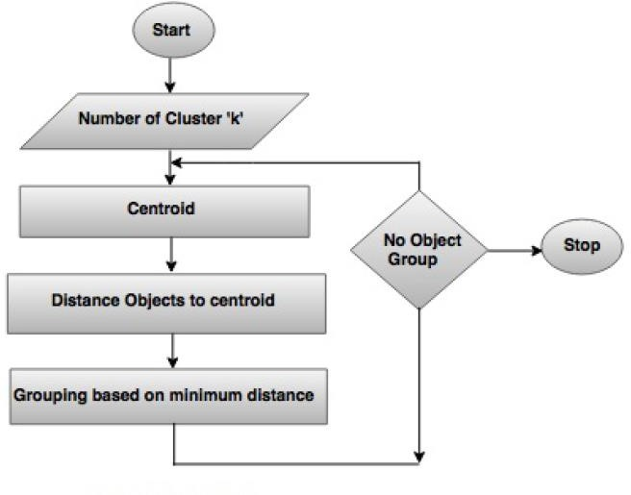
K-means algorithm

Slide 26
Example
One dimensional
Apply K-means algorithm in given data for k=3. Use C₁(2) , C₂(16) and C₃(38) as initial cluster centers. Data: 2, 4, 6, 3, 31,12,15,16, 38, 35, 14, 21, 23, 25, 30

Slide 27
Solution
C₁(2) | C₂(16) | C₃(38)
m1 = 2 | m2 = 16 | m3 = 38
{2,3,4,6} | {12,14,15,16,21,23,25} | {31,35,38}

Slide 28
Solution
C₁(2) | C₂(16) | C₃(38)
m1 = 2 | m2 = 16 | m3 = 38
{2,3,4,6} | {12,14,15,16,21,23,25} | {31,35,38}
m1 = 3.75 | m2 = 18 | m3 = 34.67
{2,3,4,6} | {12,14,15,16,21,23,25} | {31,35,38}

Slide 29
Problem
We are given the following four data points in two dimension: XI = (2,2), X2 =(8,6), X3 =(6,8), X4
= (2,4). We want to cluster the data points into two clusters CI and C2 using the K-Means algorithm. Euclidean distance is used for clustering. To initialize the algorithm we consider CI ={xI,x3} and C2 ={x2,x4}. After two iteration of the K-means algorithm, find the cluster memberships

Slide 30
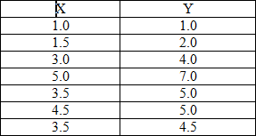
For the below dataset find out the final clusters using K-Means algorithm.
Note: i) K=2; ii) Use ‘Euclidean distance’;

Slide 31
Advantages
Fast, robust easy to understand.
Relatively efficient
Gives best result when data set are distinct or well separated from each other.

Slide 32
Disadvantages
Requires apriori specification of the number of cluster centers.
Hard assignment of data points to clusters
Euclidean distance measures can unequally weight underlying factors.
Applicable only when mean is defined i.e. fails for categorical data.
Only local optima

Slide 33
Hierarchical clustering

Slide 34
Hierarchical clustering
Bottom-up or Agglomerative clustering
  Start considering each data point as a singleton cluster
  Successively merge clusters if similarity is sufficiently high
  Until all points have been merged into a single cluster
Top-down or Divisive clustering
  Start with all data points in a single cluster
  Iteratively split clusters into smaller sub-clusters if the
similarity between two sub-parts is low

Slide 35
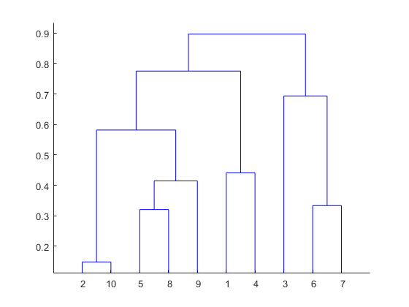
Both Divisive and Agglomerative clustering can be represented as a Dendrogram

Slide 36
Basic agglomerative hierarchical clustering algorithm
Start with each item in a singleton cluster
Compute the proximity/similarity matrix between clusters
Repeat
  Merge the closest/most similar two clusters
  Update the proximity matrix to reflect proximity between the new cluster and the other clusters
Until only one cluster remains

Slide 37
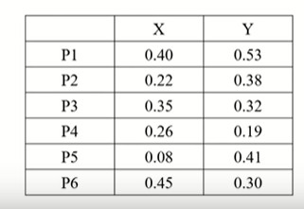
agglomerative hierarchical clustering

Slide 38
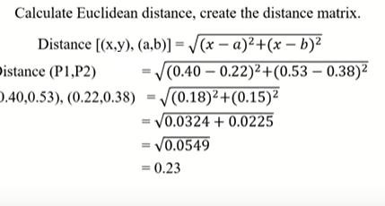
Basic agglomerative hierarchical clustering algorithm

Slide 39
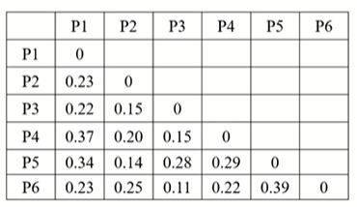
agglomerative hierarchical clustering

Slide 40
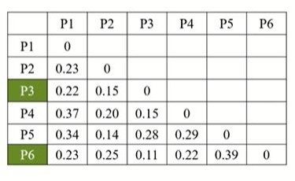
agglomerative hierarchical clustering

Slide 41
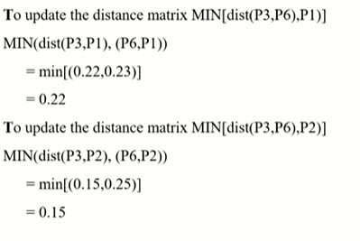
agglomerative hierarchical clustering

Slide 42
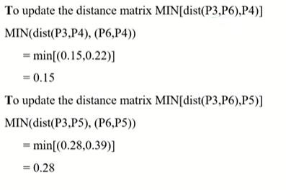
agglomerative hierarchical clustering

Slide 43
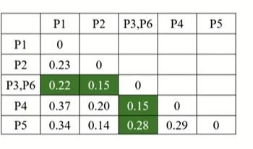
agglomerative hierarchical clustering

Slide 44
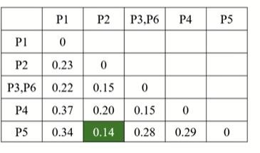
agglomerative hierarchical clustering

Slide 45
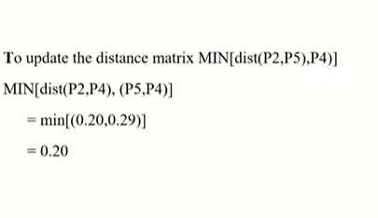
agglomerative hierarchical clustering

Slide 46
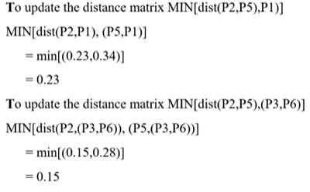
agglomerative hierarchical clustering

Slide 47
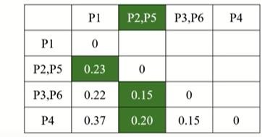
agglomerative hierarchical clustering

Slide 48
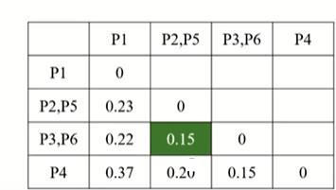
agglomerative hierarchical clustering

Slide 49
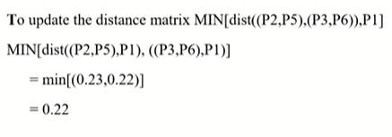
agglomerative hierarchical clustering

Slide 50
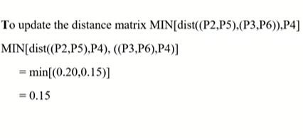
agglomerative hierarchical clustering

Slide 51
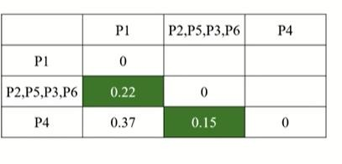
agglomerative hierarchical clustering

Slide 52
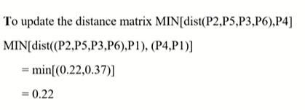
agglomerative hierarchical clustering

Slide 53
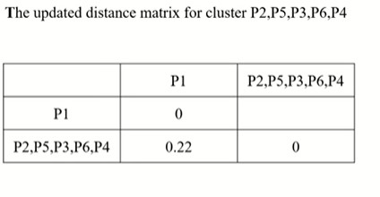
agglomerative hierarchical clustering

Slide 54
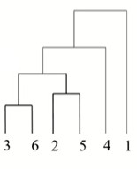
agglomerative hierarchical clustering

Slide 55
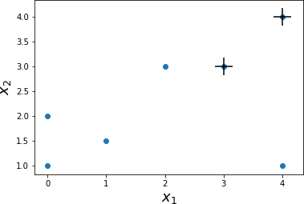
K-means: Numerical Problem
Initial Centroids
– C₁ = (4, 4)
– C₂ = (3, 3)
Distance between C₁ and (0, 1)
= (4 − 0)²+(4 − 1)²
= (4)²+(3)² = 5
X₁ | X₂ | Cluster Assigned
4 | 4 | 1
0 | 1 | None
2 | 3 | None
4 | 1 | None
3 | 3 | 2
1 | 1.5 | None
0 | 2 | None

Slide 56
K-means: Numerical Problem
Initial Centroids
– C₁ = (4, 4)
– C₂ = (3, 3)
Distance between C₂ and (0, 1)
= (3 − 0)²+(3 − 1)²
= (3)²+(2)² ≈ 3.6
X₁ | X₂ | Cluster Assigned
4 | 4 | 1
0 | 1 | None
2 | 3 | None
4 | 1 | None
3 | 3 | 2
1 | 1.5 | None
0 | 2 | None

Slide 57
K-means: Numerical Problem
Initial Centroids
– C₁ = (4, 4)
– C₂ = (3, 3)
Distance between C₁ and (0, 1) = 5
Distance between C₂ and (0, 1) = 3.6
Point (0, 1) is nearer to C₂ and thus
assigned to cluster ‘2’
Repeat the process for all data points
X₁ | X₂ | Cluster Assigned
4 | 4 | 1
0 | 1 | 2
2 | 3 | None
4 | 1 | None
3 | 3 | 2
1 | 1.5 | None
0 | 2 | None

Slide 58
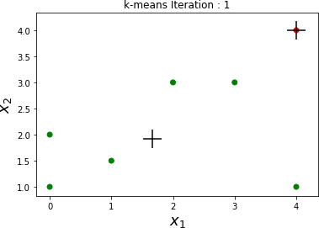
K-means: Numerical Problem
After First Iteration:
– C₁ = (4, 4)
– C₂ = (1.66, 1.91)
How do we calculate C₂ ?
– By taking average of all points assigned to
cluster ‘2’
X₁ | X₂ | Cluster Assigned
4 | 4 | 1
0 | 1 | 2
2 | 3 | 2
4 | 1 | 2
3 | 3 | 2
1 | 1.5 | 2
0 | 2 | 2
_{C = (}0+2+4+3+1+0 , 1+3+1+3+1.5+2
•
)
2
6 6
10 11.5
= ( ,
) ≈ (1.66,1.91)
6 6

Slide 59
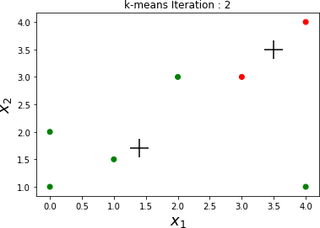
K-means: Numerical Problem
After First Iteration:
– C₁ = (4, 4)
– C₂ = (1.66, 1.91)
After Second Iteration:
– C₁ = (3.5, 3.5)
– C₂ = (1.7, 1.7)
X₁ | X₂ | Cluster Assigned
4 | 4 | 1
0 | 1 | 2
2 | 3 | 2
4 | 1 | 2
3 | 3 | 1
1 | 1.5 | 2
0 | 2 | 2

Slide 60
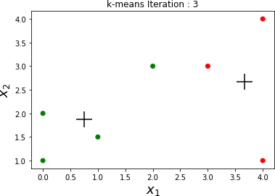
K-means: Numerical Problem
After First Iteration:
– C₁ = (4, 4)
– C₂ = (1.66, 1.91)
After Second Iteration:
– C₁ = (3.5, 3.5)
– C₂ = (1.7, 1.7)
After Third Iteration:
– C₁ = (3.66, 2.66)
X₁ | X₂ | Cluster Assigned
4 | 4 | 1
0 | 1 | 2
2 | 3 | 2
4 | 1 | 1
3 | 3 | 1
1 | 1.5 | 2
0 | 2 | 2
– C = (0.75, 1.86)
2

Slide 61
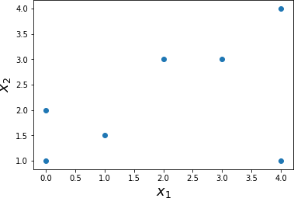
K-means: Numerical Problem
Consider the following Data Points
Apply k-means with k = 2
Distance metric = Euclidean
X₁ | X₂ | Cluster Assigned
4 | 4 | None
0 | 1 | None
2 | 3 | None
4 | 1 | None
3 | 3 | None
1 | 1.5 | None
0 | 2 | None

Slide 62
K-means: Numerical Problem
Initial Centroids
– C₁ = (4, 4)
– C₂ = (3, 3)
X₁ | X₂ | Cluster Assigned
4 | 4 | 1
0 | 1 | None
2 | 3 | None
4 | 1 | None
3 | 3 | 2
1 | 1.5 | None
0 | 2 | None

Slide 63

K-means: Numerical Problem
After Third Iteration:
– C₁ = (3.66, 2.66)
– C₂ = (0.75, 1.86)
After Fourth Iteration:
– C₁ = (3.66, 2.66)
– C₂ = (0.75, 1.86)
The algorithm stops, as there is no change in centroids
X₁ | X₂ | Cluster Assigned
4 | 4 | 1
0 | 1 | 2
2 | 3 | 2
4 | 1 | 1
3 | 3 | 1
1 | 1.5 | 2
0 | 2 | 2

Slide 64
Proximity/similarity between clusters
MIN similarity between two clusters: Proximity (similarity) between the closest (most similar) two points, one from each cluster (minimum pairwise distance)
MAX similarity between two clusters: Proximity between the farthest two points, one from each cluster (maximum pairwise distance)

Slide 65
Types of hierarchical clustering
Complete linkage
  Merge in each step the two clusters with the smallest
maximum similarity
Single linkage
  Merge in each step the two clusters with the smallest
minimum similarity

Slide 66
What is Cluster Analysis?
Finding groups of objects such that the objects in a group will be similar (or related) to one another and different from (or unrelated to) the objects in other groups
Inter-cluster distances are maximized
Intra-cluster distances are minimized

Slide 67
Quality: What Is Good Clustering?
A good clustering method will produce high quality clusters
  high intra-class similarity: cohesive within clusters
  low inter-class similarity: distinctive between clusters
The quality of a clustering method depends on
  the similarity measure used by the method
  its implementation, and
  Its ability to discover some or all of the hidden patterns
79

Slide 68
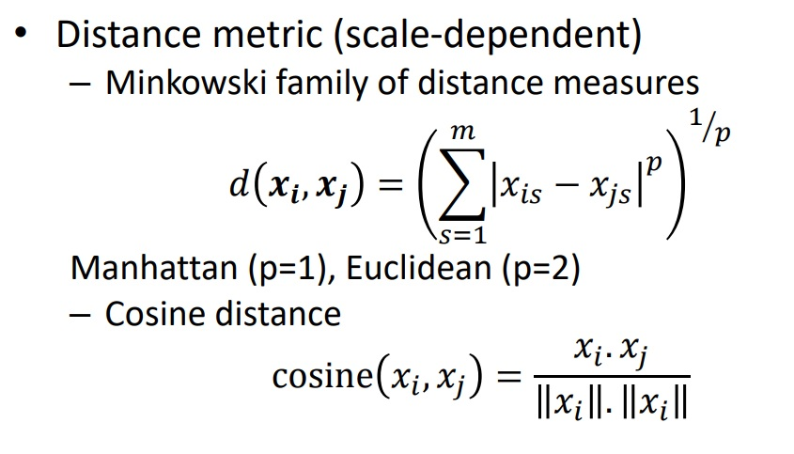
(Dis)similarity measures
𝑖
𝑖

Slide 69
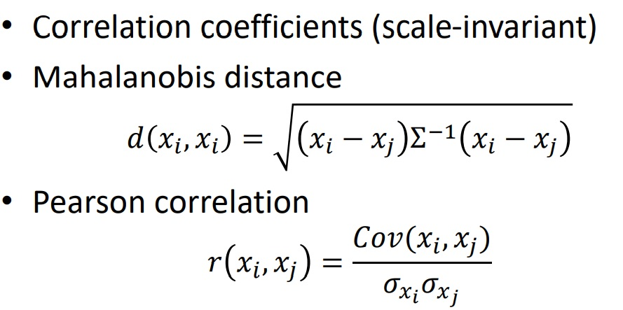
(Dis)similarity measures

Slide 70
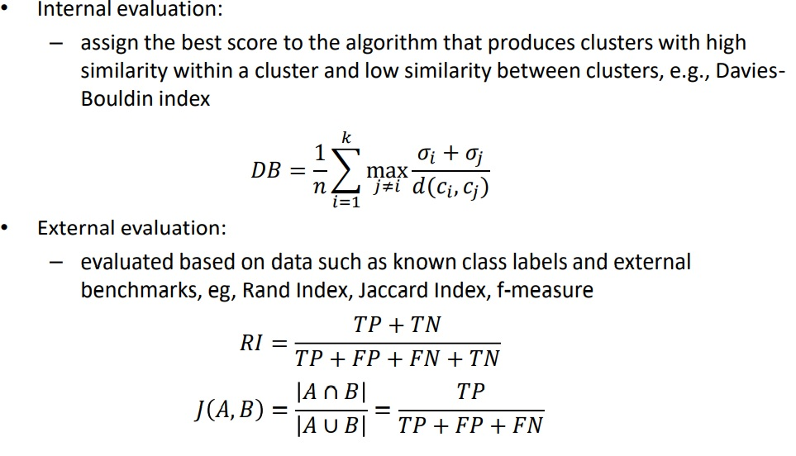
Quality of Clustering

